Slide 1
Never Enough Time for Everything?
A Department Chair’s Survival guide: Using your resources, and other Useful insights Into the Job
Presented by Jim Gray Florida Atlantic University

Slide 2

Oh my, How Your Life Has Changed, since you became the “Boss”
But there are some things you can do to keep control of most of it.

Slide 3
Areas that will be different Overnight…
Relationships:
Perceptions:
Environment:
With your Peers
With the Staff
With upper Administration
With your Students
With the Community
Your perceptions of others
Others’ perceptions of you
Relative importance of tasks
Critical attention to details
Authority and power issues
Work environment
Personal space and time
Control of your work
Control of your time
Preserving your sanity

Slide 4
First, lets look at how your Relationships have changed:
With Peers: You are now “The BOSS”

Slide 5
First, lets look at how your Relationships have changed:
Because You are now “The BOSS” This puts you under immediate suspicion of having gone over to THE DARK SIDE

Slide 6
First, lets look at how your Relationships have changed:
With Staff: You are now someone to be feared, not just tolerated

Slide 7
First, lets look at how your Relationships have changed:
With Staff, they now really do not know how they are supposed to relate to you.
It is up to you to put them at ease…

Slide 8
First, lets look at how your Relationships have changed:
With Administration: you are now one of them, although they are not sure about you either!

Slide 9
First, lets look at how your Relationships have changed:
With Students: you are now thought of as having the power to “fix stuff”

Slide 10
First, lets look at how your Relationships have changed:
With Community: you are now more of a symbol of the university and of your program
You also have to think more about what those community stakeholders need from you…

Slide 11
Changed Perceptions:
Your perceptions of others

Slide 12
Changed Perceptions:
Others’ perceptions of you

Slide 13
Changed Perceptions:
Relative importance of tasks

Slide 14
Changed Perceptions:
Critical attention to details

Slide 15
Changed Perceptions:
Authority and power issues

Slide 16
Changed Perceptions:
Your perceptions of others
Others’ perceptions of you
Relative importance of tasks
Critical attention to details
Authority and power issues

Slide 17
Changes in your Environment:
Work environment
Personal space and time
Control of your work
Control of your time
Preserving your sanity

Slide 18
Changes in your Environment:
Work environment

Slide 19
Changes in your Environment:
Work environment
Personal space and time

Slide 20
Changes in your Environment:
Work environment
Personal space and time
Control of your work

Slide 21
Changes in your Environment:
Work environment
Personal space and time
Control of your work
Control of your time

Slide 22
Changes in your Environment:
Work environment
Personal space and time
Control of your work
Control of your time
Preserving your sanity (what’s left of it)

Slide 23
Attributions are going to be made about your motives...

Slide 24
Attributions are going to be made about your motives... (Even when you sneeze!)

Slide 25
Attributions are going to be made about your motives... (Even when you sneeze) So just get used to it…

Slide 26
Here are some other aspects of your new dilemma:
Students now expect:
Instantaneous response
Absolute accuracy
Unfailing courtesy
Perfect diplomacy ...along with...
Fairness as they see it

Slide 27
Here are some other aspects of your new dilemma:
Faculty now expect
Instantaneous response
Absolute accuracy
Unfailing courtesy
Perfect diplomacy ...along with...
Fairness as they see it

Slide 28
Here are some other aspects of your new dilemma:
Dean now expects:
Instantaneous response
Absolute accuracy
Unfailing courtesy
Perfect diplomacy ...and “by the way”...
Peace in the department

Slide 29
Control over your time is not going to be nearly as easy as it used to be...

Slide 30
Control over your time is not going to be nearly as easy as it used to be... “got a minute?”

Slide 31



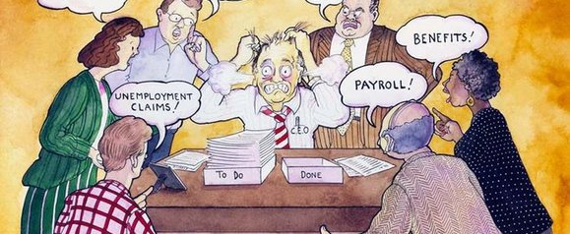

Here is the crux of the Time problem:
Stock Vector Illustration:
Image ID: 116435299
Stock Vector Illustration:
Image ID: 116435299
You cannot possibly remember all this stuff; yet… You are expected to have it instantly available, always!

Slide 32


The secret weapon (good notes!)

Slide 33
You are now “official”

Slide 34
You are now “official” and that means...

Slide 35
You are now “official” and that means... There is no longer any such thing as “off the record” DON’T KID YOURSELF. There are no “PRIVATE CONVERSATIONS” anymore

Slide 36
Pointers Collected by watching the best
Delegation
Relationships
Follow-up
Staff want meaningful tasks
Give specific direction
Make expectations clear
Set a date for completion
Avoid verbal requests
Know your people
Spend time really listening
Personalize communications
Listen first, pause, respond
You may sometimes be the only “adult-in-the-room”
The list of Critical Dates
The Reminder/Tickler File
Automatic reminders
Checking up as a regular event
Don’t play “gotcha!”

Slide 37
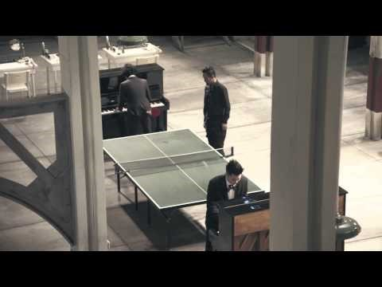
Ever Have a Day Like This?

Slide 38
More Great Benchmarks
Take control of your office space and time
Stand up to greet people as they enter (this exudes courtesy)
For a short meeting—Never sit back down. (try this, it usually works)
When it does not work, walk toward the door! (this always WORKS!)
Ask these questions as politely as you can:
Can this wait until tomorrow?
I have about three minutes, will that be enough time?
What do you think should happen?
Does this consider everyone involved?
After a while, folks will get the message...

Slide 39
Things I have learnt thru Example
Have your own data before you even ask the question
Ask where the data being presented to you originated
Don’t be shy about asking for corroboration/elaboration
When you delegate responsibility, also include confidence:
“I will support whatever decisions you make in my absence”

Slide 40
Develop Good Listener Skills it also helps to keep good notes!
Sometimes all the other person wants is for somebody to listen
When you think you understand, ask if your summary is accurate
What do you need? / Can you survive without it?
Always wait until you have “the rest of the story”
There is always another perspective to consider
Things frequently dissipate in the face of focused impartial attention
There are, however, exceptions to the rules...

Slide 41
URGENT vs. IMPORTANT few situations are ever “both”
Many times, by just letting some time pass, a majority of situations will resolve themselves without your intervention
Other times, you have to act quickly and enforce your best judgment, to avoid a regrettable escalation
Knowing how to tell the difference is a key skill that you should work to develop
Unfortunately you will learn this the hard way, like everyone who has gone before you...

Slide 42
It will be OK. You will get the hang of this
Just don’t let it go to your head.
Keep on being yourself, but be more perceptive of others’ expectations!
Nobody likes a martinet.

Slide 43

Wisdom for the Ages
“This too, shall pass”
©1978 California Prune Advisory Board

Slide 44
The end…
Beam me up, Scotty!

